Slide 1
CI 101Q
Introduction to Vienna 1900
IFritz Kreisler

Slide 2
Why Vienna 1900?
End-of-century phenomena in European cultural history, “the sense of an ending” (Frank Kermode), have always fascinated me.
Periods of stress and innovation engender both chaos and creativity
The last years of Habsburg Vienna provide all this and more… ground-breaking innovations set in an end-of-days atmosphere.
Fritz Kreisler 1905
Notes:
By training I am a scholar of modernism. My particular focus is Germany and Austria, the German-language cultures of Central Europe.
The decades around the turn of the twentieth century marked the end of the centuries’ old Habsburg dynasty. Vienna, its capital, was the locus of a great ferment in European culture in this era of political and social disintegration. Fin-de-siècle Vienna was simultaneously the city of Freud, Klimt, Kokoschka, Schiele, Mahler, Strauss, Schönberg, Schnitzler, von Hofmannsthal, Wittgenstein, Herzl, Boltzmann, and Mach. Study of this urban microcosm provides us an intriguing introduction to cultural modernism manifested in the physical sciences, in psychology, in art and music, and in the politics of both anti-Semitism and Zionism.

Slide 3
Where to start?
Janik & Toulmin begin with reference to the waltz.
A popular dance form in the 19th Century, essentially Viennese
Speech and individual movement were not free in the autocratic Habsburg dynasty, but once the band started up everyone could dance with abandon.

Slide 4
Waltzes
Johann Strauss. Waltzes
https://www.youtube.com/watch?v=MZi5AIjw7wo
Voices of Spring 1882 (Frühlingsstimmen)
“…modern exorcism…capturing our senses in a sweet trance” (a visitor from Germany, 1870’s)
Ravel, “La valse” 1919. His take on the end of an era. https://www.youtube.com/watch?v=Fg2i2NB-i3o
Janik and Toulmin in Wittgenstein's Vienna see Ravel’s piece as a musical parable of the modern cultural crisis

Slide 5
Waltz
What sounds to modern ears as orderly and structured must have sounded quite different in the 19th Century.
The rapid turns and flourishes expressed sexual tension and release in a way no other popular form allowed.
Balls were big events, and held for all social classes.

Slide 6
The threats to order and stability
On the surface it was possible then, especially if you were well off, to think of the world of Vienna in, say, 1890 as orderly and stable.
This was an illusion
In retrospect it could seem a dream
It is the forces that destroyed this illusion that is the true subject of this course.

Slide 7
Modernism
Modernism in culture studies does not carry the (common-sense) notion of “what is new to us.”
By modernism we refer specifically to a period in the Western tradition around 1900.
Writers, artists, composers, scientists, physicians, and scholars during this time saw themselves as innovators and pioneers of new forms.
Roughly, our period covers the latter part of the 19th Century, and ends with the First World War

Slide 8
-ism Carrousel
Friedrich Nietzsche: “I am dynamite…the history of the humanity breaks in two parts: there is a time before me and a time after me.”
Nietzsche’s ironic trope provides the strongest statement of what it means to be a modernist.
Modernism incorporated a carousel of –isms: Naturalism, Symbolism, Impressionism, Expressionism, Futurism, etc.
Notes:
Ism carousel from Jost Hermand Synthetisches Interpretiern
“Vienna in the fin-de-siècle, with its acutely felt tremors of social and political disintegration, proved one of the most fertile breeding grounds of our century's a-historical culture. Its great intellectual innovators—in music and philosophy, in economics and architecture, and of course, in psychoanalysis– all broke, more or less deliberately, their ties to the central to the nineteenth century liberal culture in which they had been reared.” (Schorske 1981: xviii)

Slide 9
Pre-conditions for Modernism
Despite the traditional forces of social control, Vienna, by the end of the century, exhibited all the preconditions for Modernism to flourish
Big, getting bigger. Immigrants quadrupled the city’s population between 1857 and 1910
Rich
Polyglot
Jammed with original minds: Young men and women whose parents had come from the provinces to make their fortunes

Slide 10
Freud
Sigmund Freud (1856 –1939)
neurologist
known as the father of psychoanalysis
M.D. at University of Vienna in 1881
research into cerebral palsy, aphasia and microscopic neuroanatomy at the Vienna General Hospital
Hypnotism, hysteria
Psychoanalysis

Slide 11
Klimt
Gustav Klimt (1862- 1918)
painter
Vienna Secession
Great success, socially and financially
Mentor and supporter of younger artists who followed

Slide 12
Klimt

Slide 13
Oskar Kokoschka
1 March 1886 – 22 February 1980) was
artist
Poet and playwright
expressionist
Portraits, landscapes

Slide 14
Kokoschka

Slide 15
Egon Schiele
1890 –1918
Expressionist painter
protégé of Gustav Klimt,
a major figurative painter
noted for its intensity and its raw sexuality,
the many self-portraits, including naked self-portraits.

Slide 16
Schiele

Slide 17
Mahler
1860 –1911
Composer
Conductor
Vienna Court Opera
New York Philharmonic

Slide 18
Richard Strauss
1864 –1949
composer of the early modern era
known for his operas:
Rosenkavalier, Electra

Slide 19
Schönberg
1874 –1951
Expressionist composer and painter
leader of the Second Viennese School
Nazis labeled Schoenberg's works “Degenerate”
he emmigrated to the United States in 1934.

Slide 20
Fritz Kreisler
1875-1962
Jewish heritage, baptized at 12 yrs.
Prodigy: Toured Europe and America before 1890
Rejected by Vienna Philharmonic

Slide 21
Arthur Schnitzler
1862 – 1931
Playwright, novelist
Young Vienna (Jung Wien)

Slide 22
Hugo von Hofmannsthal
1874 – 1929
Poet from an early age
Linked with R. Strauss for opera libretti (Rosenkavalier, Elektra)

Slide 23
Ludwig Wittgenstein
1889 – 1951
Son of one of Europe’s richest families
Served as officer in WWI
Philosopher, emigrated to England (Cambridge)

Slide 24
Theodor Herzl
1860 –1904
Journalist, playwright, political activist
After covering the Dreyfus affair as a journalist
Became one of the fathers of modern political Zionism
Herzl formed the World Zionist Organization and promoted Jewish migration to Palestine in an effort to form a Jewish state

Slide 25
Ernst Mach
1838 –1916
Physicist and philosopher
contributions to physics such as the Mach number and the study of shock waves
philosopher of science
a major influence on logical positivism, American pragmatism
through his criticism of Newton, a forerunner of Einstein's relativity.

Slide 26
Ludwig Boltzmann
physicist and philosopher
Developer of statistical mechanics
explains and predicts how the properties of atoms
(mass, charge, and structure)
determine the physical properties of matter
(such as viscosity, thermal conductivity, and diffusion).

Slide 27
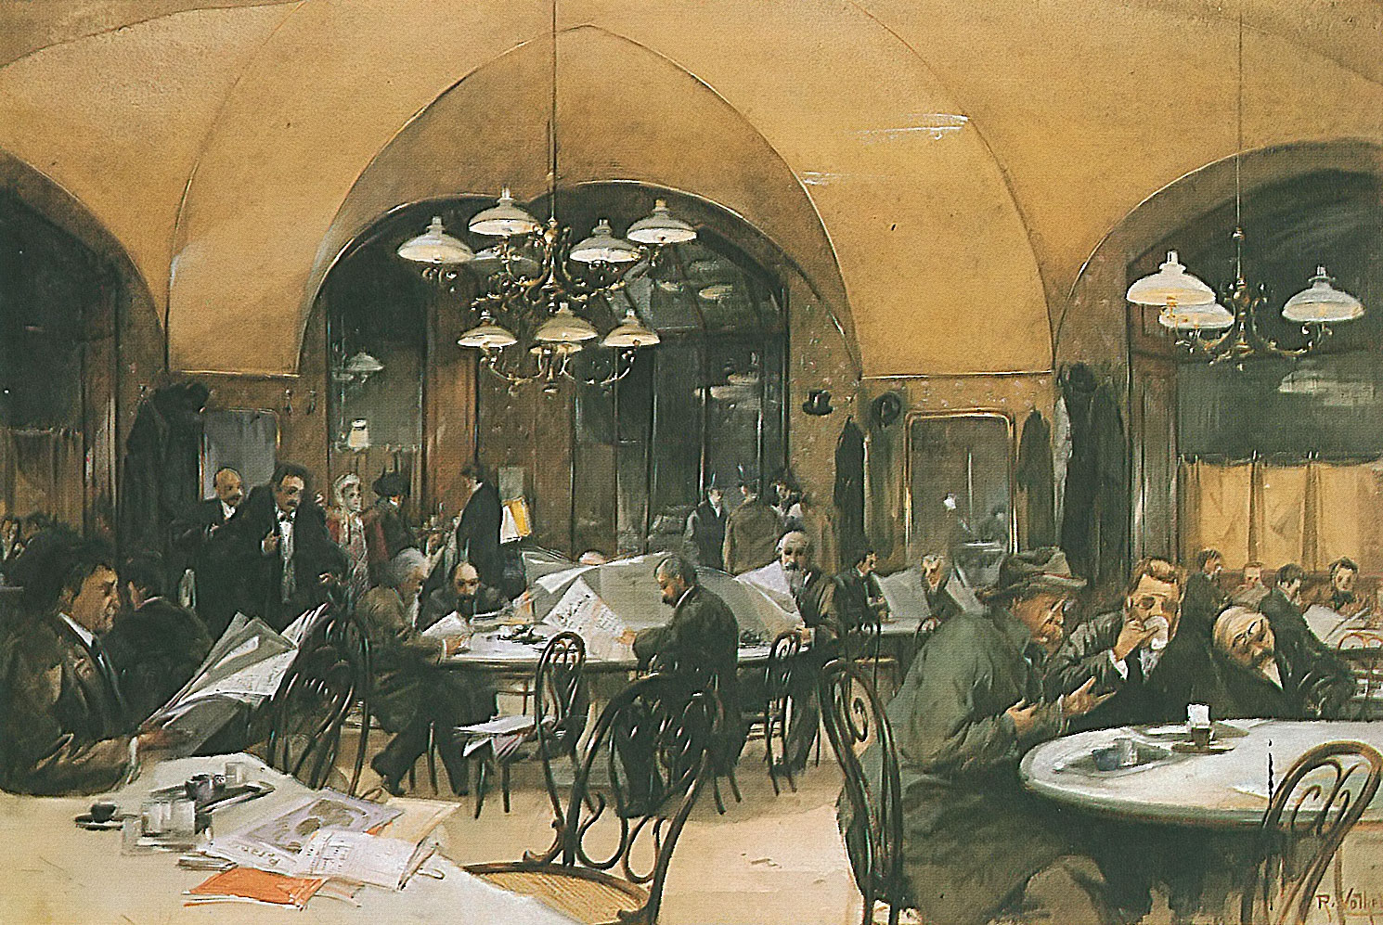
The charm of cafés
The delightful cafés lining the streets of Vienna, where one can sit the whole day with a single cup of coffee or glass of wine, reading newspapers and magazines from all over the world, formed an essential part of the Viennese way of life; … the embodiment of a relaxed, carefree existence. But… there was another side to this institution.

Slide 28
Themes of this course
Creativity and Innovation
In physical sciences, medicine, psychology
In the visual arts, literature and music
Urban Multi-culturalism
Immigration and Assimilation
Antisemitism and Zionism
Interdisciplinary cross-fertilization

Slide 29
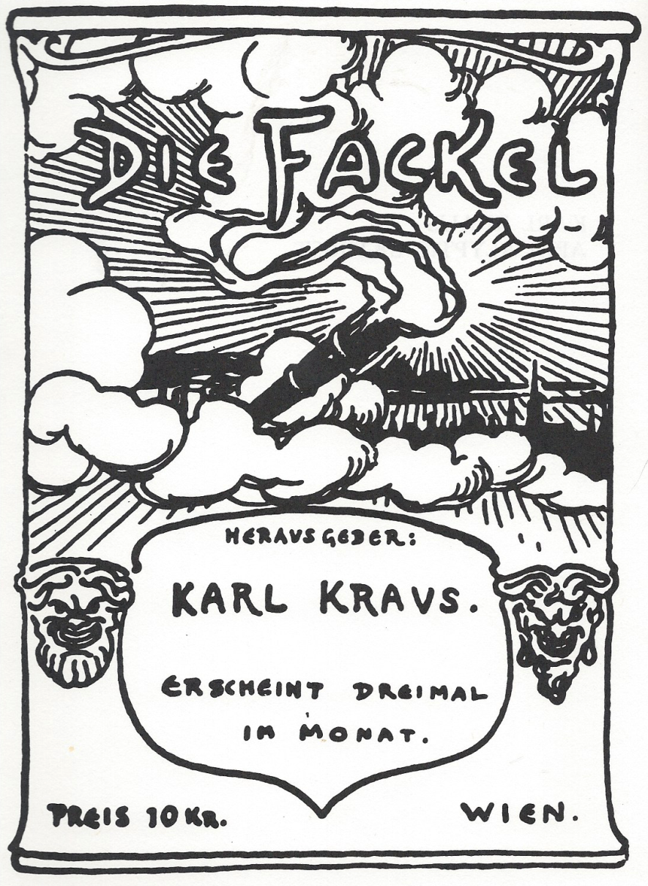
The last years of Habsburg Vienna
Complex, Rich, Influential
microcosm of the 20th century
Experimental station for the destruction of the world (Versuchsstation für die Weltvernichtung)

Slide 31
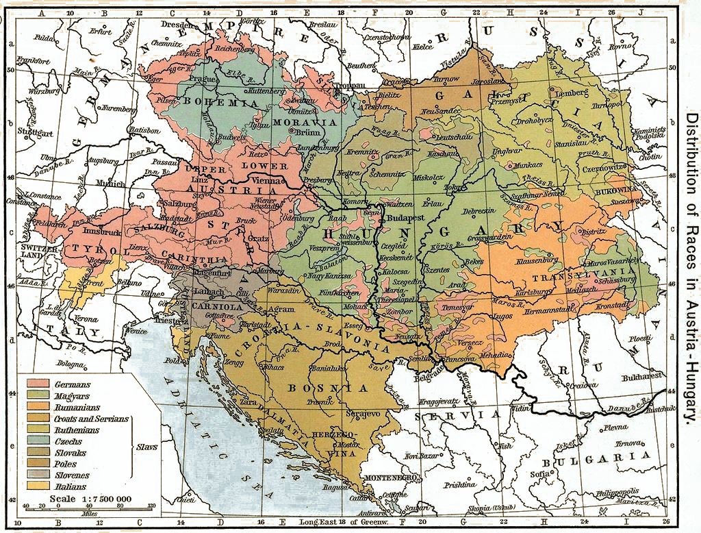
Where is Vienna

Slide 32
Vienna 1800

Slide 33
Vienna 1850

Slide 34
Vienna 1900

Slide 35
Viennese resistance to change
Vienna, the capital of the most catholic country east of Spain, was a thoroughly conservative city.
Until the end of the 19th Century, innovations, the new, was routinely ignored
Vienna was the capital of an empire of peasants
as much as 1/3 of the land was owned by 3% of the populace [Everdell]

Slide 36
Viennese resistance to change
Railroads had been banned until quite late, for fear that they would bring “masons” and the Revolution to the city
Baron Uchatius invented the motion picture projector in 1858. he used it to teach ballistics and then sold it to a stage magician.
Siegfried Marcus drove Vienna’s first automobile down the street in 1875, he got no orders, and was forgotten
In 1880 a gasoline-powered flight by Wilhelm Kress crashed and was forgotten
Emperor Franz Josef remained skeptical of telephones, telegraphs, typewriters, electric lights and elevators until the 1890’s (His daughter-in-law, Princess Stephanie, had to pay to have bathrooms constructed in his palace. )
Notes:
* Everdell. The first Moderns, pp13 ff

Slide 37
As the Good Old Days drew to a close…
Vienna was above all a city of the bourgeoisie. … Vienna had been a commercial center from time immemorial and had been the center of large-scale public administration since the reign of Maria Theresa, the Viennese bourgeoisie acquired its individual character during the third quarter of the nineteenth century.
“This was the period of industrial expansion, when vast fortunes were made and lost by the investor, the industrial organizer, or the man with an innovative manufacturing technique ...the material fortunes on which the next generation depended for leisure in which to cultivate the arts.” (Janik & Toulmin)

Slide 38
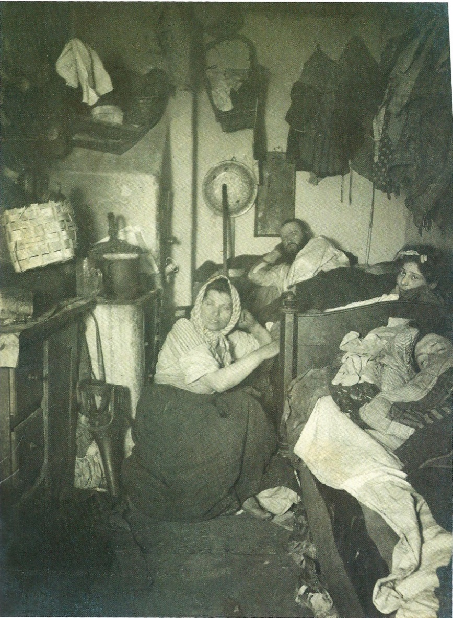
The other side…
Throughout the nineteenth century Vienna had a grave housing shortage.
Viennese working-class housing has always been inadequate, both in quality and in quantity.
Apartments were dreary and impossible to heat adequately,
A need to escape these dingy and cold living quarters, hence the warmth and cheer of the ubiquitous cafés.
The charm of the cafés was the other face of the hard realities of life as most Viennese knew it;
Notes:
Similar ambiguities characterized many aspects of Viennese life. (Janik & Toulmin)

Slide 39
Liberal culture
Schorske’s definition:
“Traditional liberal culture had centered upon rational man. Whose scientific dominion of nature and whose moral control of himself were expected to create the good society.” (p.4)
This is the backdrop against which 20th century scholars saw the last years of the Habsburg monarchy and the society over which it ruled.

Slide 40
The charm of cafés
The delightful cafés lining the streets of Vienna, where one can sit the whole day with a single cup of coffee or glass of wine, reading newspapers and magazines from all over the world, formed an essential part of the Viennese way of life; … the embodiment of a relaxed, carefree existence. But… there was another side to this institution.

Slide 41
upper middle class
One of our concerns is for the aesthetic culture of the educated bourgeoisie in the last half of the 19th century, and the first decade of the 20th.
These exponents of the modern liberal culture confronted in Vienna at the end of the century the older aristocratic culture of sensuous feeling and grace. (an “unstable compound”)

Slide 42
Historical/political Background
1848: across Europe, the liberals and radicals lost out in the struggle against aristocracy and baroque absolutism.
The Habsburgs established their own version of Constitutional monarchy:
actually a bureaucratic monarchy.
The parliament could be shut down but never the imperial bureaucracy.
Military defeats let the liberals govern for a few years 1860’s – 1880’s; but their political power was short-lived.
Short-lived, because the base was so narrow: primarily “German” Austrians and “German” Jews, many of whom were assimilated.
Toward the end of the century new groups began to demand inclusion and put that inclusion above all else, including the liberal values
Anti-Semitic Christian Socials and Pan-Germans, Slavic nationalists, socialists
Christian Socials began to win Vienna mayoral elections and only the Emperor prevented that party from taking office. Eventually (1897) they took over

Slide 43
Middle class and aristocratic values
Architecture (Ringstrasse and more)
Patronage of performing arts
As Schorske points out, by the 1890’s the heroes of the middle class were “no longer political leaders, but actors, artists and critics” (p. 8)
“The educated bourgeoisie had appropriated the aesthetic sensuous sensibility, but in a secularized, distorted, and in a highly individuated form.” (p.10)
To the Viennese bourgeoisie nothing was more important than the arts, especially literature, theater and music. In large part because of being effectively locked out of the exercise of political power.

